Slide 1
Presentation on DRIP IRRIGATION
Ch . madhan
188TIA0105
II B .Tech
Department of Civil Engineering
DBSIT , KAVALI.

Slide 2
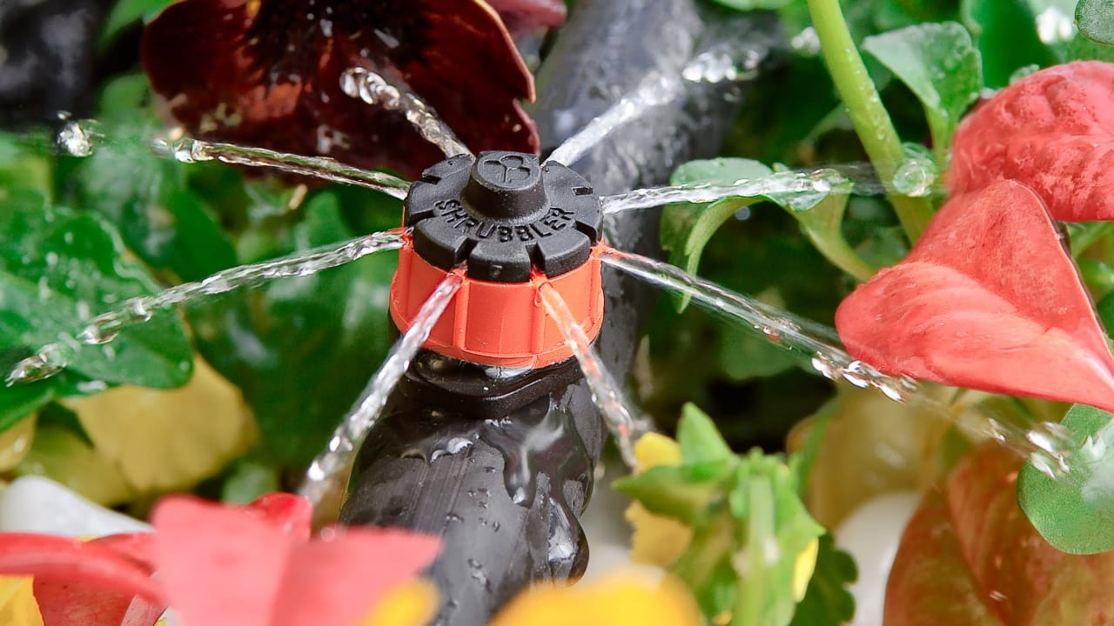

Slide 3
Contents
Introduction
Characteristics of Drip Irrigation
Methods of drip irrigation
Advantages
Disadvantages
conclusion

Slide 4
Introduction
Drip irrigates the plant not the soil
It delivers the water by a pipe (small diameter) with smart holes
The water flow rate is low & uniform
So that every plant gets the same amount of water

Slide 5
Characteristics of Drip irrigation
Adapts easily to flat topography.
Can function with no outlet drainage facilities.
Fertilization through the system is very convenient.

Slide 6
Methods of Drip irrigation
Pivot / sprinklers
Rain feed
Drip
Flood /Furrow

Slide 7
Advantages
Increased yield.
Water, labor & Energy saving.
Less problem of disease & Pest.
This method is specially suitable for vegetables , fruits & cotton Etc…
Drip system produces healthy , fast growing plants.

Slide 8
Disadvantages
Pipe blockage.
Need regular maintenance.
High price & Expensive equipment.

Slide 9
Conclusion
This system is very user friendly and having lot of advantages.
It is very cheap and reliable system having less disadvantages.
To achieve the nations goal of having three times meal for everyone.

Slide 10


